Slide 1
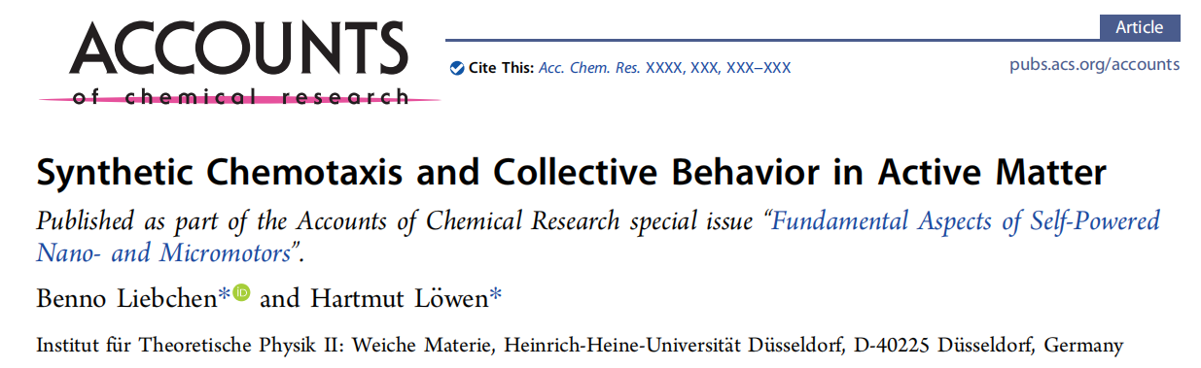
Literature Reading & Review

Slide 2
Background
Liebchen, B.; Cates, M. E.; Marenduzzo, D. Pattern formation in chemically interacting active rotors with self-propulsion. Soft Matter 2016, 12, 7259.
Liebchen, B.; Marenduzzo, D.; Cates, M. E. Phoretic interactions generically induce dynamic clusters and wave patterns in active colloids. Phys. Rev. Lett. 2017, 118, 268001.
Synthetic Chemotaxis and Collective Behavior in Active Matter

Slide 3
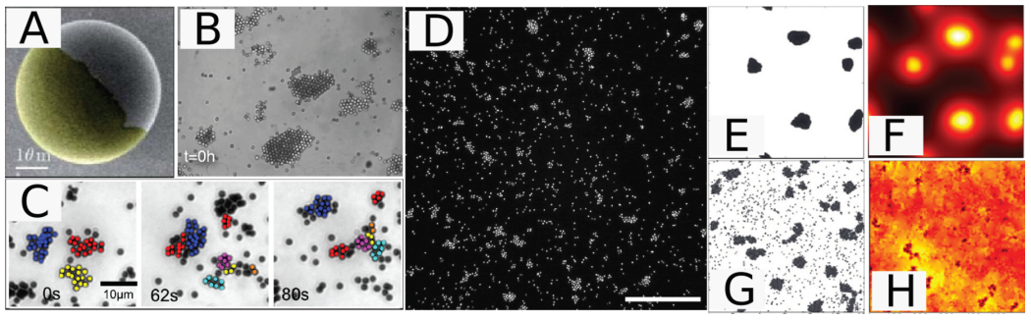
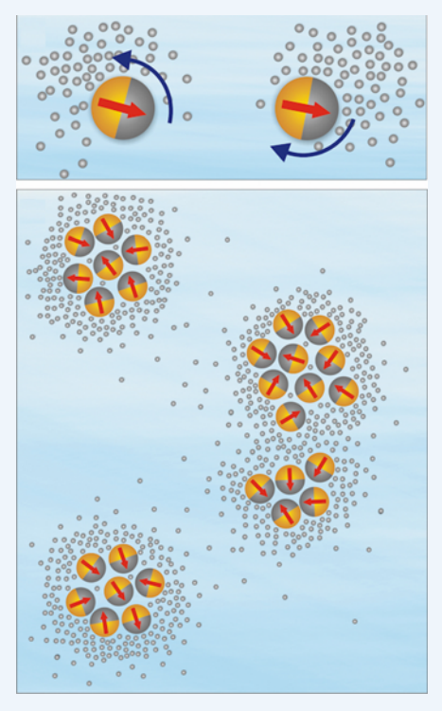
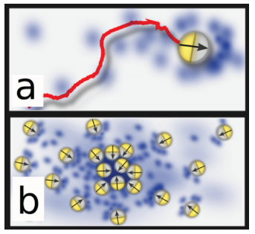
Background
Self-propelled
Instability (swarming)
Interaction fields
Self-produced
Taxis (chemotaxis, thermotaxis, phototaxis, viscotaxis(viscosity))
Dictyostelium, autoinducers
Synthetic Chemotaxis and Collective Behavior in Active Matter

Slide 4
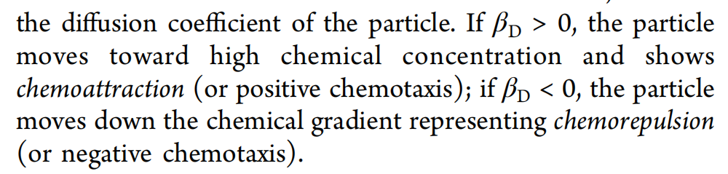
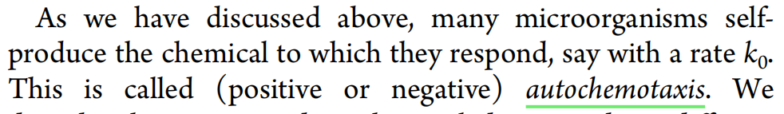
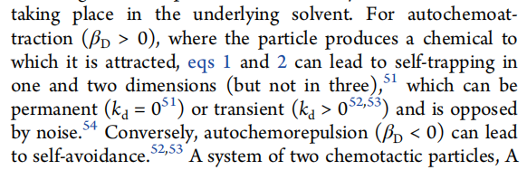
The Model
CHEMOTAXIS IN ISOTROPIC PARTICLES
One Particle
Synthetic Chemotaxis and Collective Behavior in Active Matter

Slide 5
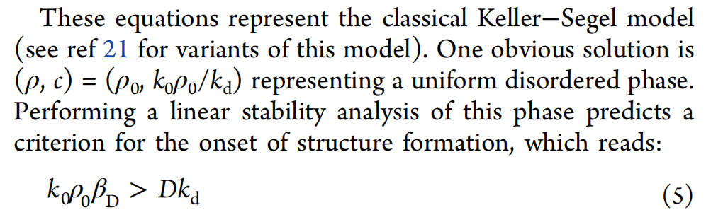
The Model
Collective Behavior: Keller−Segel Model
Synthetic Chemotaxis and Collective Behavior in Active Matter

Slide 6
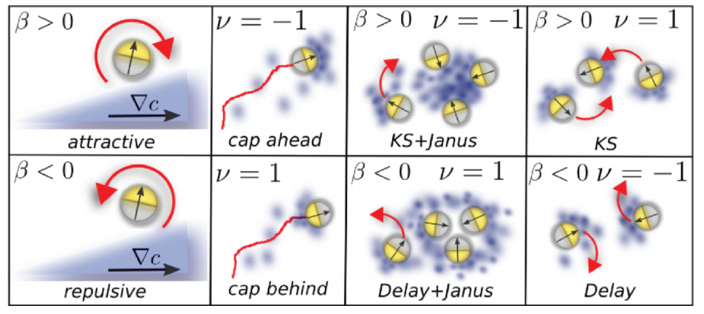
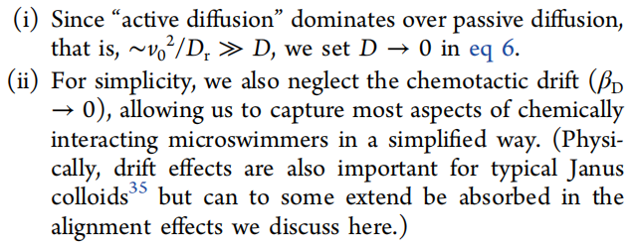
The Model
CHEMOTAXIS IN ACTIVE PARTICLES
Active Particles in Imposed Gradients
Collective Behavior: The Phoretic Brownian Particle Model
Liebchen, B.; Marenduzzo, D.; Cates, M. E. Phoretic interactions generically induce dynamic clusters and wave patterns in active colloids. Phys. Rev. Lett. 2017, 118, 268001.

Slide 7
The Model
Field Theory of the Phoretic Brownian Particle Model
Liebchen, B.; Marenduzzo, D.; Cates, M. E. Phoretic interactions generically induce dynamic clusters and wave patterns in active colloids. Phys. Rev. Lett. 2017, 118, 268001.

Slide 8
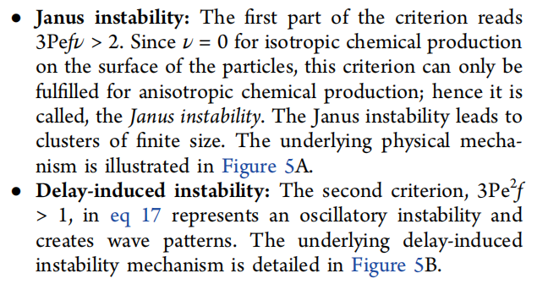
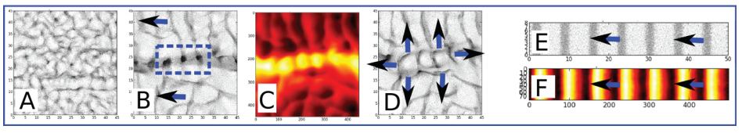
The Model
Parameter Collapse and Universality
Chemorepulsive Route to Pattern Formation
Liebchen, B.; Marenduzzo, D.; Cates, M. E. Phoretic interactions generically induce dynamic clusters and wave patterns in active colloids. Phys. Rev. Lett. 2017, 118, 268001.

Slide 9
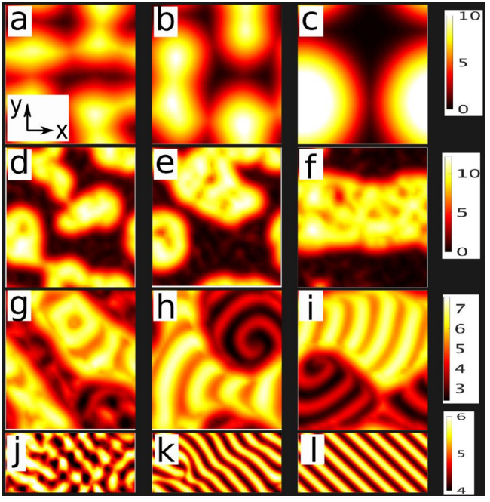
The Model
BEYOND THE ACTIVE BROWNIAN PARTICLE
MODEL: CHIRALITY
Synthetic Chemotaxis and Collective Behavior in Active Matter

